Slide 1
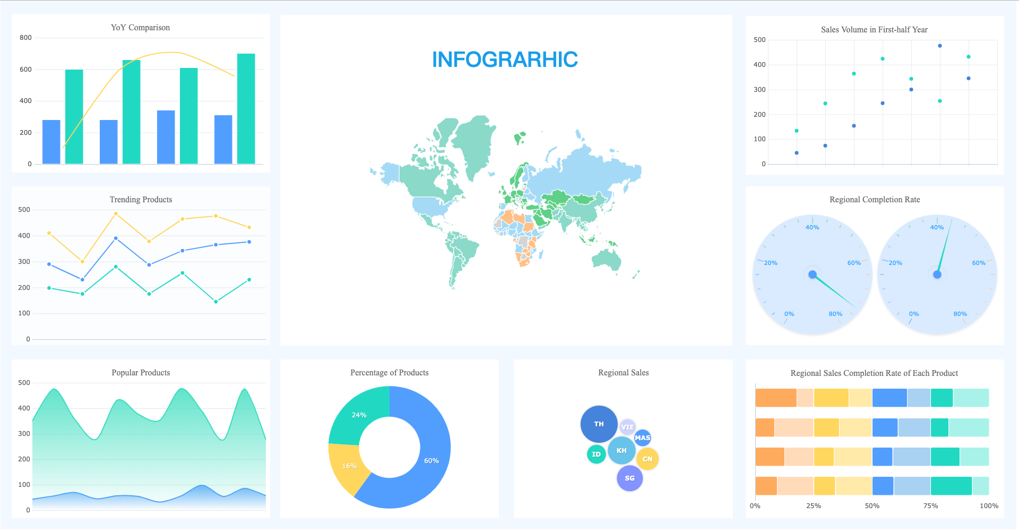
Module 2: Data Visualization and Communication Data Visualization using PowerBI
Siddharth Sundar
MyAnatomy Integration
NCET Core Team

Slide 2
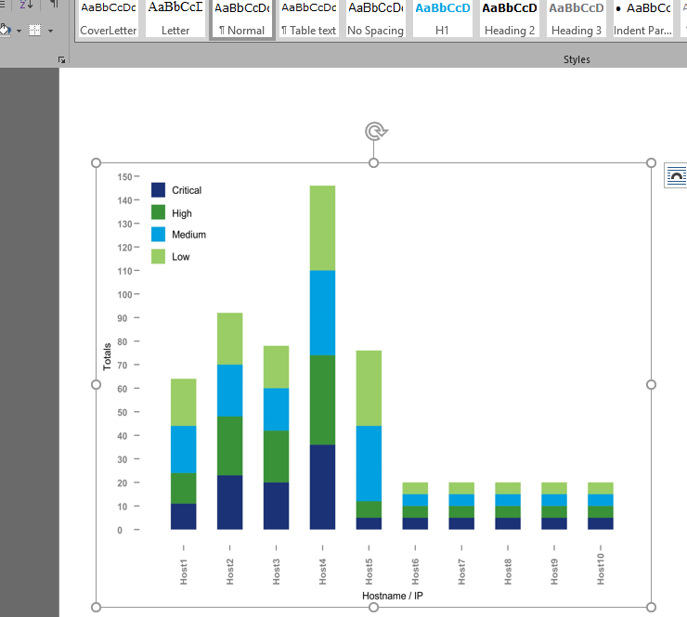
What is PowerBI?
PowerBI is a data visualization and reporting platform, created by Microsoft.
It is used by Businesses and Professionals on a regular basis.
Microsoft PowerBI is a robust tool for analysts to create visually appealing dashboards that help stakeholders understand data, with just a look.

Slide 3
Features of PowerBI?
PowerBI has a suite of features that make it one of the most sought-after solutions for creating dashboards and visualizations.
Features include:
Various Connectors (Excel, SQL Servers, other Cloud Platforms)
Can be integrated within a website
Can be used to track KPIs in real-time.
Data modelling feature to define tables, measures, and relationships.
Power Query for cleaning and transforming data
Custom Visuals and Add-Ons
… and many more

Slide 4
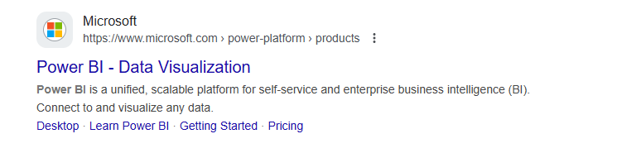
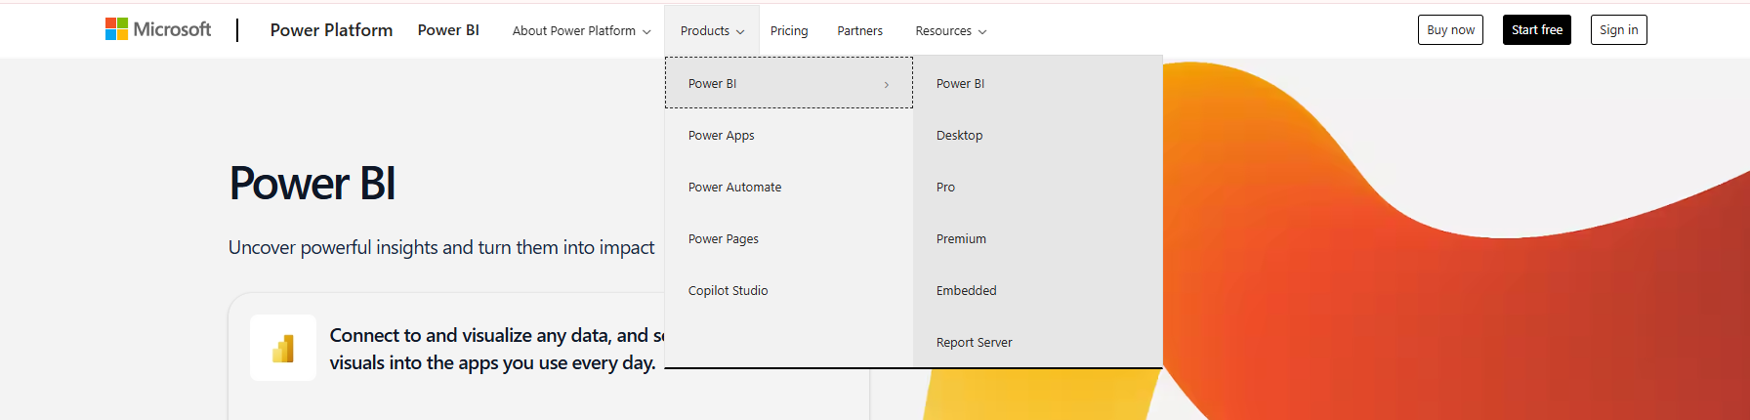
How to Install PowerBI?
Search for “PowerBI” on Google.
Click on this link and navigate to the “Products” > “Power BI”> “Desktop” page

Slide 5
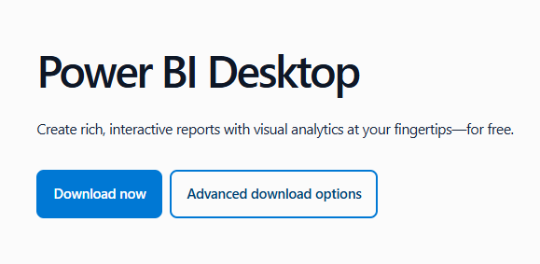
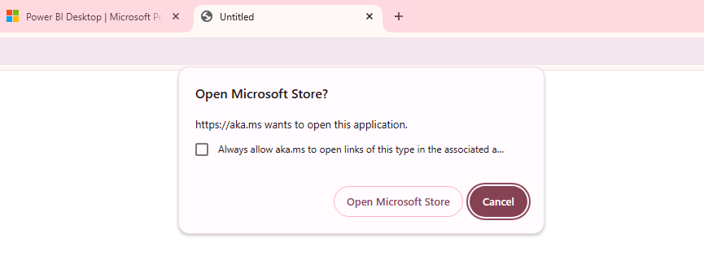
How to Install PowerBI?
Here, you will see a download button, click on it –
There, you will get an alert asking to open “Microsoft Store”, Open

Slide 6
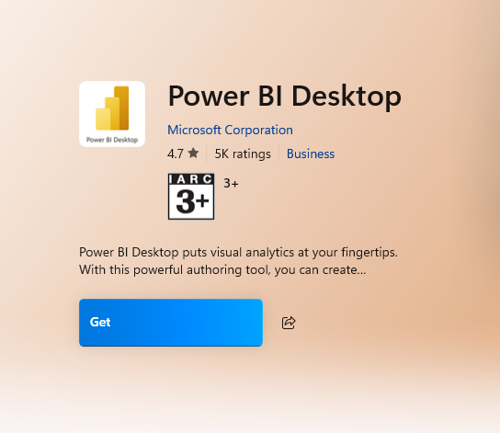
How to Install PowerBI?
Finally, you will see one page on the “Microsoft Store”, click on “Get”
Congratulations, you have installed “PowerBI”

Slide 7
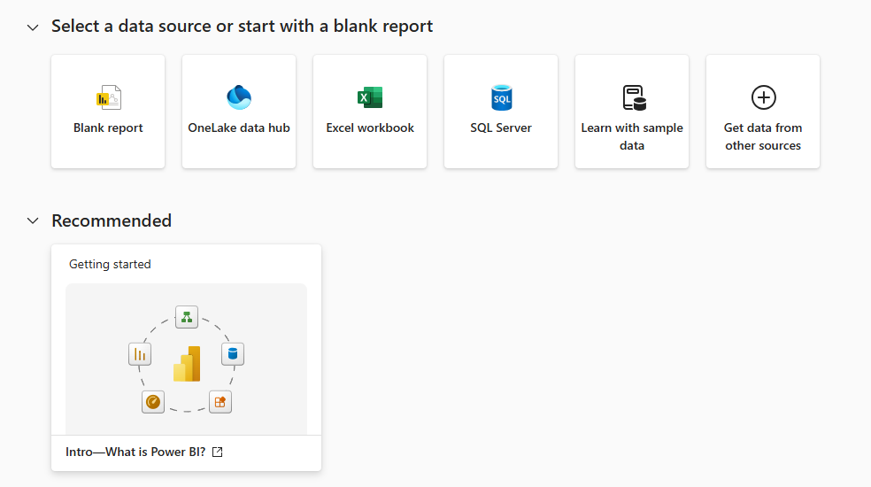
Getting Started - PowerBI
After installing, you will see this Screen, click on “Blank Report”.

Slide 8
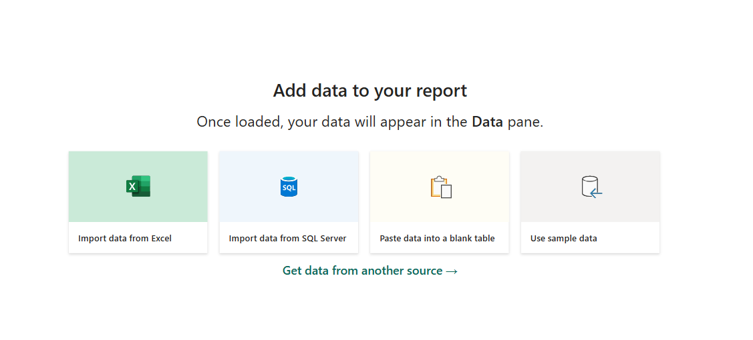
Getting Started - PowerBI
This is the page that you will get, this is the new page for your file.
The first step you will do is, you will click on the “Import Data from Excel”, to begin with the visualizations.

Slide 9
Getting Started - PowerBI
This is the page that you will get, this is the new page for your file.
On your left side panel, you will see 4 icons. These are 4 “Views” or screens, that have different functionalities. Let us understand them one by one.
Report view
Table view
Model view
DAX Query view

Slide 10
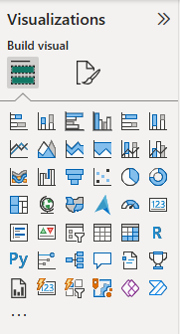
Report View - PowerBI
This is the page where you will be creating dashboards.
You can create as many visualizations as you like, and combine it within the sheet.
Most of our work on “PowerBI” will be on the report view page.
When on the report view page, you will get access to various visualizations that you can add to your dashboard depending on what you want to visualize and analyze.

Slide 11
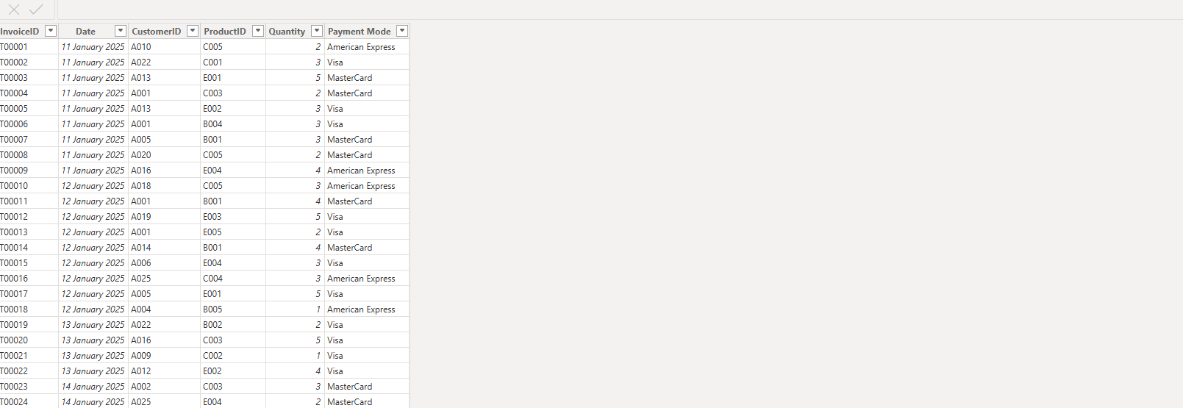
Table View - PowerBI
This is the page where you will be handling tables.
The Table View will give you all information regarding your data, and you can transform it according to your needs also.

Slide 12
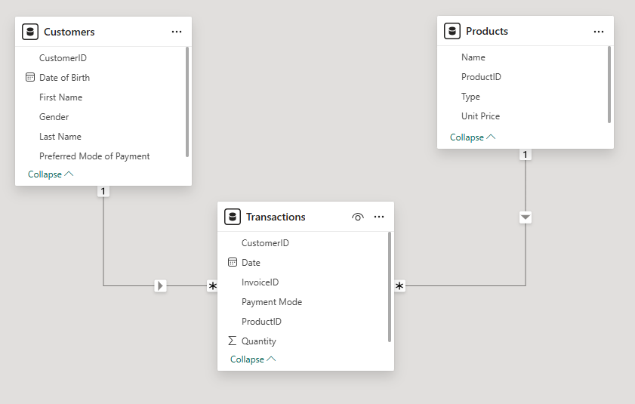
Model View - PowerBI
The Model view is for relationship management of different tables on PowerBI. Currently, I am having 3 tables, which I will be using on PowerBI, to show you, how it works.
My Data Model Looks like this with 3 tables, “Customers”, “Products”, and “Transactions”.
Customers and Transactions have 1-to-Many Relationship
Products and Transactions also have 1-to-Many Relationship
Products and Customers have no relationship.

Slide 13
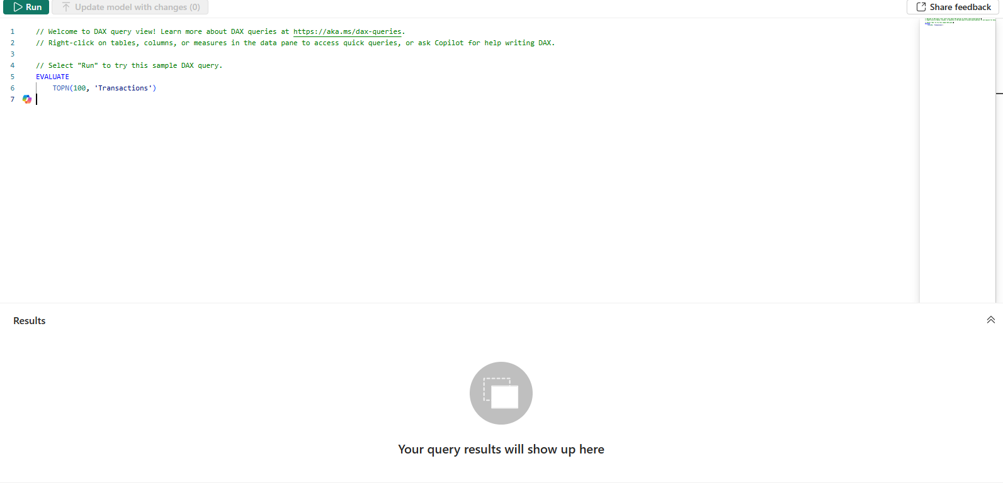
DAX Query View - PowerBI
The DAX Query View is slightly advanced, it is for using writing queries to get some rows. It is slightly similar to SQL querying.
This is what the DAX Query View looks like. We will explore it later.

